Slide 1
CAPSTONE PROJECT
Banking Loan & Financial Transaction Automation Testing
Para Bank

Slide 2
profile
NAME:- SAIKETHAN RANGINENI
DOMAIN:- JAVA SELENIUM
BATCH:- 9

Slide 3
What is automation testing
Automation Testing uses software tools to run test cases automatically.
Reduces manual effort, increases speed, and improves accuracy.
Ensures regression coverage: same tests can be re-run quickly after each change.
In this project: Selenium WebDriver + TestNG + Java used to automate Para Bank demo application.

Slide 4
Project description
Built a Capstone Project:- Param Bank Automation Test Suite using:
Java, Selenium WebDriver, TestNG, Maven
Applied Page Object Model (POM) for maintainability.
Automated 30 functional test cases across critical modules:
Login
Account Balance (Accounts Overview)
Loan Requests
Fund Transfers
Features:
Explicit waits & robust locators - stable execution
Screenshots on failures - quick debugging
Transaction History

Slide 5
Login test cases
1. valid Login() — Valid login; verifies dashboard/accounts overview and then logs out.
2. invalid Login - Wrong Password() — Wrong password shows error.
3. invalid Login Wrong User() — Non existent username shows error.
4. empty Credentials() — Empty username & password shows error.
5 .multiple Invalid Attempts() — Repeated wrong attempts produce error / lockout message.
6. valid Login With Uppercase Username() — Uppercase username currently
7. login Without Password() — Missing password shows error.
8. logout After Login() — Login then logout; verifies login page/content appears after logout.
9. valid Login With Uppercase Password() — Uppercase Password currently fails
10. login Without Username() — Missing password shows error.

Slide 6
Loan test cases
1. apply Valid Loan – Apply a valid loan and verify result.
2. apply Loan Exceeding Balance – Apply loan greater than balance.
3. apply Loan Zero Down Payment – Loan with 0 down payment.
4. apply Loan Invalid Input – Non-numeric inputs (ABC/xyzzy).
5. apply Minimum Loan Amount – Apply very small loan.
6. apply Maximum Loan Amount – Apply very large loan.
7. apply Loan Empty Fields – Submit without filling fields.
8. apply Loan Down Payment Greater than Amount – Invalid case.
9. apply Loan Multiple Loans Limit – Check max concurrent loans.

Slide 7
Login test cases
1. valid Login() — Valid login; verifies dashboard/accounts overview and then logs out.
2. invalid Login - Wrong Password() — Wrong password shows error.
3. invalid Login Wrong User() — Non existent username shows error.
4. empty Credentials() — Empty username & password shows error.
5 .multiple Invalid Attempts() — Repeated wrong attempts produce error / lockout message.
6. valid Login With Uppercase Username() — Uppercase username currently
7. login Without Password() — Missing password shows error.
8. logout After Login() — Login then logout; verifies login page/content appears after logout.
9. valid Login With Uppercase Password() — Uppercase Password currently fails
10. login Without Username() — Missing password shows error.

Slide 8
Transfer test cases
1. Parameterized Transfers
2. Valid transfer
3. Small transfer (like $2)
4. Invalid transfer (e.g., to a non-existing account)
5. Negative amount transfer
6. Exceeding balance transfer
7. Transfer Negative Amount (explicit)
8. Try transferring a negative amount; expect rejection.
Transfer Invalid Accounts (explicit)
9. Try transferring between non-existent accounts; expect error.

Slide 9
Balance and Transaction test cases
1. Balance After Deposit (Balance)
After a deposit, check Accounts Overview shows updated balance. 1. recent Transfer Appears In History (Transaction)
Verify a newly made transfer shows up in history.
2. Search By Amount(Transaction)
Search by amount field → expect results.
3. Search By Date (Transaction)
Search by date range → expect results or “no transactions” message.

Slide 10
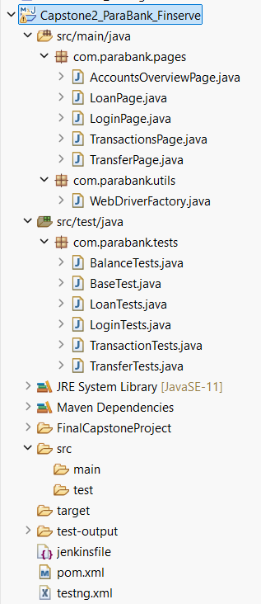
Framework architecture

Slide 11
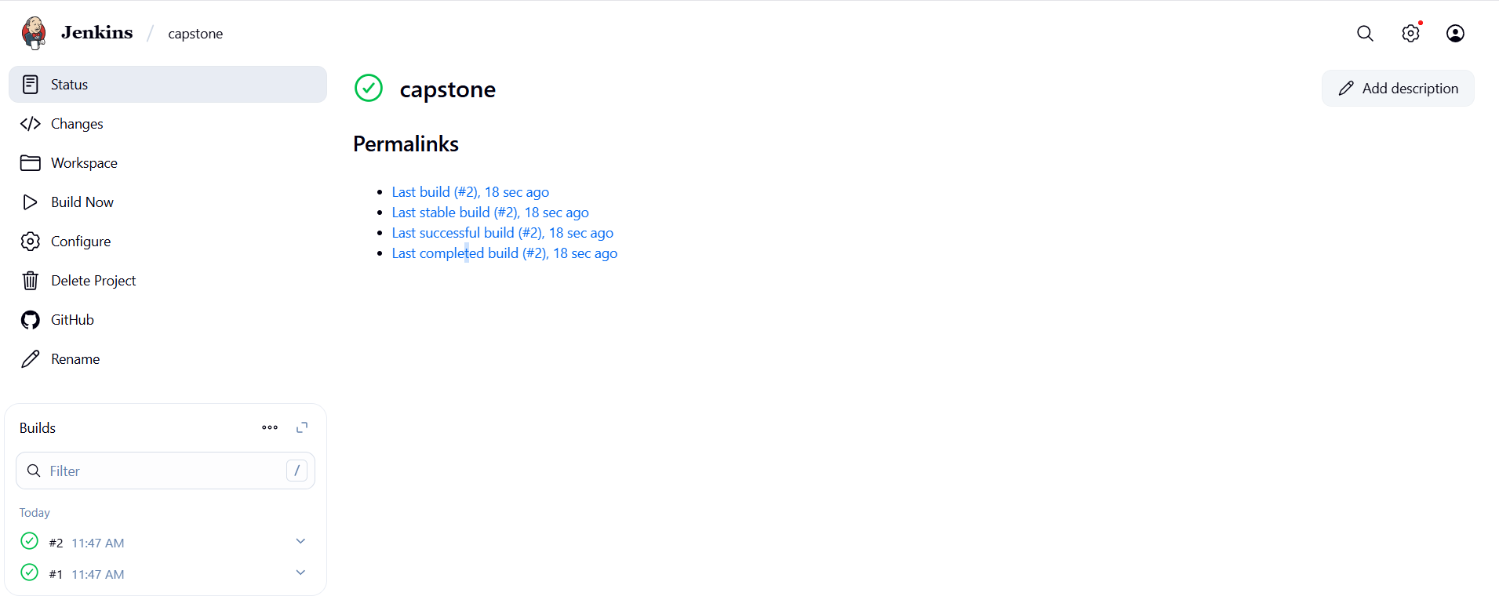
Jenkins

Slide 12
Sample codes
@Test
public void validLogin() {
LoginPage lp = new LoginPage(driver);
lp.login("john", "demo");
Assert.assertTrue(lp.isLoggedIn(), "Should be logged in");
lp.logout();
}
@Test
public void invalidLoginWrongPassword() {
LoginPage lp = new LoginPage(driver);
lp.login("john", "wrongpass");
Assert.assertTrue(lp.isLoginError(), "Error should be displayed");
}

Slide 13
conclusion
Built a scalable, maintainable automation framework for a Para banking application.
Automated 30 test cases across Login, Balance, Loan, Transfer, and Transaction modules.
Reduced manual testing effort, ensured consistency, and improved confidence in application quality.
Future scope: Integrate Allure/Extent Reports for advanced reporting, parallel execution, and expand test
coverage to bill payments & profile updates.

